Slide 1
Building on Your Success from
Sir Thomas Boteler Church Of England High School
Adam Bird

Slide 2
What we will cover today:
How your GCSE results can make a difference to your options
Different courses at college
Where you can go for further information
Important dates and events

Slide 3
Better GCSE results will provide more options after school!
Colleges will look at:
Your overall average GCSE point score to determine your level of programme
Your GCSE point score for individual subjects will also be looked at for certain A-levels

Slide 4
Grading for GCSEs 2018 Grade: Points:
9 | 8
8 | 7.67
7 | 7
6 | 6.33
5 | 5.67
4 | 5
3 | 4
2 | 3
1 | 1
Progression to Level 3 Programme:
You need to be aiming to achieve at least grade 4s and 5s in all subjects to maximise your options.
If you do not achieve a GCSE Grade C/4 in English and/or Maths you will be required to improve in these subjects.
Please also remember that many universities will require you to have grades 6 and above for certain GCSEs such as maths and English.

Slide 5
Some courses may also ask for additional GCSE requirements
Examples of A-levels with additional GCSE requirements:
A-level Computer Science, Chemistry, Physics and Psychology – GCSE maths Grade 5 or above.
Some A-levels such as Economics, Philosophy, PE, Geography will require a higher average GCSE point score

Slide 6
Programmes Available
Level 3 or Advanced Level
AS/A Levels
BTEC Extended Diplomas
= 3 A Levels
BTEC/OCR Diplomas
= 2 A Levels
BTEC Subsidiary / Extended Certificate /
OCR Introductory Diploma
= 1 A Levels
BTEC Certificate
= 1 AS Level

Slide 7
Programmes Available
Level 2 Courses (1 year) – For students with an average GCSE point score of at least 3.
Level 2 Vocational Qualifications | BTEC/OCR Level 2 Certificates Art and Design, Digital Art, Health and Social Care, ICT, Media Studies, Business Studies, Public Services, Science, Sport
GCSEs | Maths, English, Science
Pre GCSEs | Free Standing Maths Qualification Cambridge Progression Awards English/Functional Skills Beginners Spanish, French and German HPQ (Higher Project Qualification)

Slide 8
Subject areas you can study (over 70 courses available)…………
Art and Design
Computer Games Design
Graphics and 3D Design
Textiles
Travel and Tourism
Children’s Play, Learning and Development
English
Languages; French, Spanish and German
Law
Physics, biology, chemistry
Maths
Architecture
Criminology
Engineering
Geography and Geology
History
Psychology and Sociology
Philosophy and Religious Studies
IT and Computer Science
Drama, Dance, Performing Arts, Music
Economics, Business Studies
Sport
Public Services

Slide 9
New Courses
BTEC Level 3
Criminology
(Certificate)
A-Level Architecture
Engineering
(Certificate or Extended Certificate)

Slide 10
Extra opportunities at college:
The Graduate
Engineering Education Scheme
Music and Performance Groups (Breathe, Oxygen, Respiration)
UK and Overseas Educational Visits
Pre Medical, Pre Legal, Pre Teaching
Duke of Edinburgh Award
Specialist Guidance Team
Jobs and Apprenticeship Placements

Slide 12
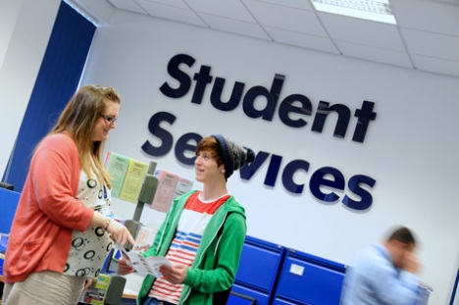
Priority Application Deadline February 2019
10 Interview Evenings from October to May.
Book an interview early for a
guaranteed place on popular
courses.
Welcome Day – TBC June/July
Registration – August 2019

Slide 13
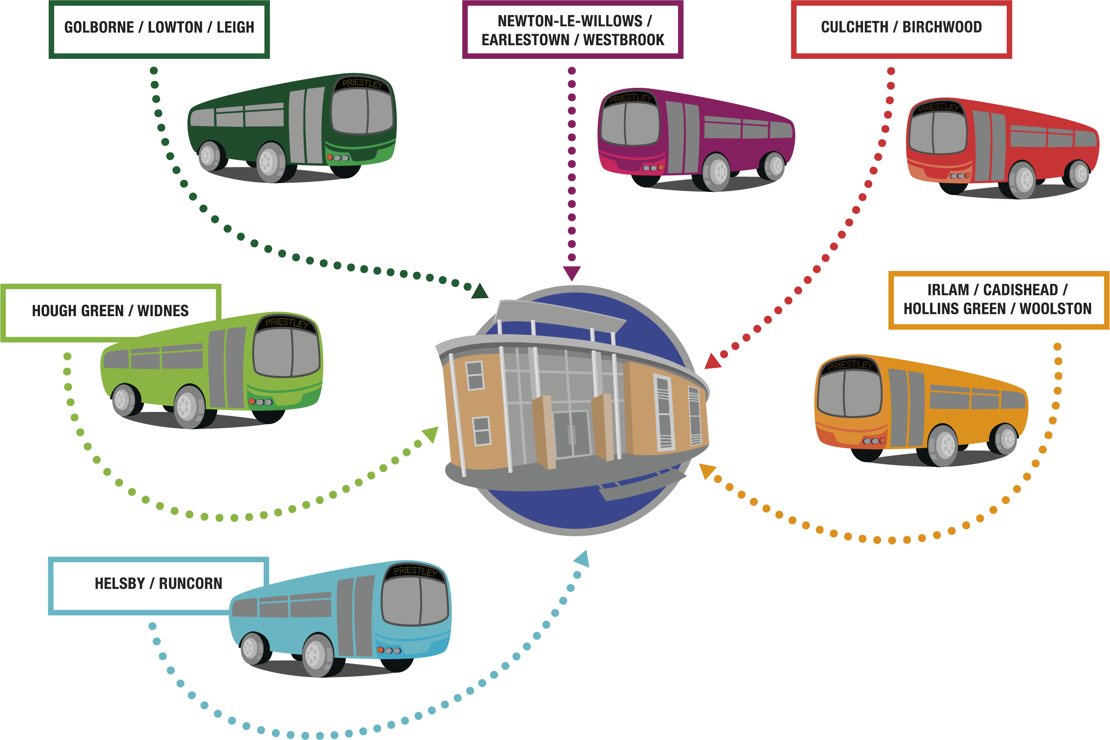

Slide 14
Good GCSE results will give you more options!
There’s still time to make a difference!
Do your very best in all your subjects
Ask if unsure about anything, talk to your teachers
Investigate all options and attend open events
Submit applications as soon as possible apply.priestley.ac.uk
If you change your mind about subjects or courses, don’t worry, that’s fine!

Slide 15
For Help, Advice and Guidance:
Adam Bird (School Liaison)
a.bird@priestley.ac.uk
Admissions
01925 624465 admissions@priestley.ac.uk
Careers, Advice and Guidance
Charlie Dunbar or Ian Edge
01925 633591

Slide 16
@priestleysfc
PriestleyCollegeWarrington
priestleysixthform

