Slide 1
YEAR 9 OPTIONS INFORMATION EVENING 2nd December 2015

Slide 2
Mr l horrigan assistant headteacher – curriculum mr j koltan assistant headteacher – pupil progress

Slide 3
Aims of the evening
To introduce parents/carers to the new performance measures linked to Progress 8 / Attainment 8
To introduce parents/carers to the new Grades for GCSE qualifications
To outline the 3 Options Pathways available to students
To outline next steps/key dates/deadlines

Slide 4
New Accountability Measures
Accountability in school terms means a policy of holding the school accountable for students’ academic progress (the results we publish)
Previously all students and schools were measured on how many GCSE’s they achieve at A*-C including English and Mathematics
From 2016 all schools will be measured on how much progress students make from when they started in Year 7 to when they complete their exams at the end of Year 11
This will be known as Progress 8

Slide 5
Progress 8
It is a type of value added measure, meaning that pupils’ results are compared to the actual achievements of other pupils with the same prior attainment
Progress 8 has been introduced for all students at KS4 and is designed to encourage students to study a broad and balanced curriculum
The new measure will be based on students’ progress measured across eight subjects not five
For each student the 8 subjects must be a combination that meets certain criteria

Slide 6
Attainment 8
Attainment 8 is a measure of a pupil’s average grade across a set suite of eight subjects.
Grades will be measured on a 1-9 point score scale
On this new scale, 1 is equivalent to a Grade G GCSE
An increase in one point will represent an increase of one GCSE grade up to 9, which is equivalent to the highest of an A* grade

Slide 8
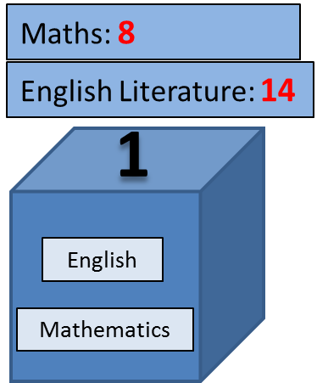
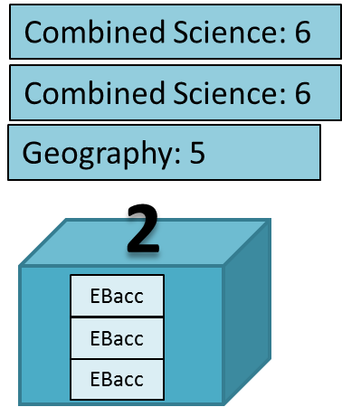
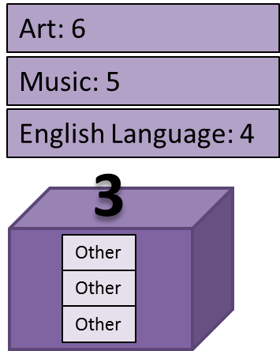
To produce the Attainment 8 score, these grades are first added together
Maths is double weighted. English Literature is also double weighted since this student has also taken English Language
The resultant score (in this case, 54) is then divided by 10 (the 8 subjects, plus the double weighting of English and Maths.)
This example student has therefore achieved an Attainment 8 score of 5.4
(8+14+6+6+5+6+4) / 10 = 5.4

Slide 9
Calculating Progress 8
It is defined as a pupil’s actual Attainment 8 score, minus their estimated Attainment 8 score
The estimated Attainment 8 score is the average Attainment 8 score of all pupils nationally with the same prior attainment at key stage 2
This prior attainment is taken as the average of a pupils KS2 English and mathematics results, in fine graded levels

Slide 10
Calculating progress 8
If a student has a KS2 average of 4.7, they would be expected to achieve an Attainment 8 grade of 49 (or 4.9)
This is based on the national average Attainment 8 score of other pupils who achieved the same KS2 results
This student achieved an actual Attainment 8 grade of 5.4
The actual attainment 8 grade (5.4) minus the expected attainment 8 grade (4.9) = a Progress 8 score of +0.5
This means that they achieved an average of half a grade better per subject than other pupils with the same prior attainment at KS2

Slide 11
Other Measures
In addition to Progress 8, each student will also leave school with the following information
Attainment 8 – showing the students’ average achievement in the same suite of subjects as the Progress 8 measure
English and Mathematics – If your child achieved a Grade 5 or better in both English (either Language or Literature) and Mathematics.
The EBacc – If your child achieved good grades (9-4) across a range of academic subjects.

Slide 12
What does this mean for my child?
Careful consideration of KS4 subject choices, moving into Year 10
Achieving across all subjects not just 5
No dropping subjects when the going gets tough
Carefully monitoring of progress all the time

Slide 13
English baccalaureate
Core Provision
English
Mathematics
Science
Optional Provision
Computing (Counts as a Science Option)
Humanities (Geography/History)
MFL (French)

Slide 14
OPTIONS PATHWAYS
3 Pathways available
1/3 enables access to 3 separate Science GCSE qualifications
Biology, Chemistry, Physics
Most Able Scientists only
Identified by Science teaching staff
2/3 enable access to the English Baccalaureate
3/3 enable access to a complete set of Progress 8 Subject
In all cases choices submitted are an indication of what students would like to study
Additional guidance may be required linked to progress

Slide 15
Pathway 1
EBACC/Progress 8 Compliant
TRIPLE SCIENCE
4 OPTION BLOCKS
Must choose
TRIPLE SCIENCE
HISTORY or GEOGRAPHY
FRENCH
+1 Free Choice

Slide 16
Pathway 2
EBACC/Progress 8 Compliant
Must Choose
HISTORY or GEOGRAPHY
FRENCH
+ 2 Free Choices

Slide 17
Pathway 3
Progress 8
CORE PROVISION
ENGLISH (Inc. ENGLISH LITERATURE)
MATHEMATICS
2 X SCIENCE
Must Choose
COMPUTING/FRENCH/GEOGRAPHY or HISTORY
+ 3 Free Choices

Slide 18
FREE CHOICES
ART
CHILD CARE
CITIZENSHIP
COMPUTING
DRAMA
FOOD PREPARATION
GEOGRAPHY
HISTORY
ICT
MUSIC
PHYSICAL EDUCATION
RESISTANT MATERIAL

Slide 19
ADDITIONAL CORE SUBJECTS
RELIGIOUS STUDIES GCSE
FULL COURSE
EXAMINATIONS AT THE END OF YEAR 11
PHYSICAL EDUCATION
NON-EXAMINATION
STATUTORY REQUIREMENTS
PSHE
DELIVERED AS PART OF THE TUTOR PROGRAMME

Slide 20
Next steps
Tonight – Meet Teachers and discuss subject material
January 2016 – Distribution of Options Booklet
Thursday 4th February 2016 - Year 9 Parents’ Evening
Gather Assessment Information/Assess subject specific suitability
Friday 12th February 2016 - Submission of Option Choices
Spring Term – Individual meetings with students to discuss choices
Summer Term – Confirmation of Option choices to students

