Slide 1
Sir Thomas Boteler Church of England High School
Bronze Duke of Edinburgh Award

Slide 2
Sir Thomas Boteler Duke of Ed
What is the Duke of Edinburgh award?

Slide 3
Sound like you?
Hardworking
Committed
Enjoys sports/the outdoors
Enjoys pushing themselves
Wants to learn new things
Wants to have great experiences
Likes to camp
Not a quitter!

Slide 4
Your chance to turn it all around!
If non of the above sound like you... Then this is your chance to turn it all around and gain some really valuable skills.

Slide 5
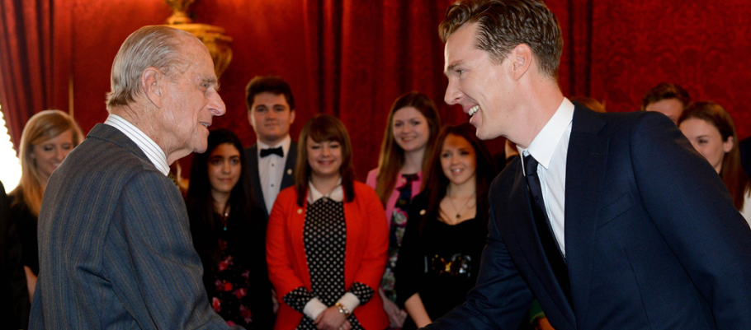
……..to a Welcome to the Palace

Slide 6
Four sections
Physical: Feel healthier, get fit!
Volunteering: Make a difference to other people’s lives
Skill: Develop a personal interest or work on a talent
Expedition: Plan for and take part in an adventure

Slide 7
Volunteering
Volunteering is simple. It’s about choosing to give time to something useful, without getting paid.
Examples
Helping people
Community action / raising awareness
Coaching/teaching/leadership
Helping a charity

Slide 8
Physical
In short, anything that requires a sustained level of physical energy and involves doing an activity.
Examples
Any kind of sport
Dance
Fitness
Martial arts

Slide 9
Skill
Ultimately you must be able to prove that you have broadened your understanding and increased your expertise in the chosen skill.
Examples:
Music
Cooking
Creatives Arts
Media and commuication

Slide 10
Working with the environment or animals
Helping a charity or community organisation
Helping people
Community action and raising awareness
VOLUNTEERING
Coaching, teaching and leadership
Environment
Helping people with special needs
Group leadership
Prefect
Supporting a charity
Cyber safety
Sports leadership
Community work
Lead a voluntary group
Notes:
Volunteering section

Slide 11
Streetdance / breakdance
Running/Jogging
Judo
Cycling
Karate
Mountain Biking
Swimming
Squash
Yoga
Rugby
Trampolining
Ice skating
Cheerleading
Caving
Aerobics
PHYSICAL
Golf
Tap Dancing
Skateboarding
Ballet
Pilates
Gym
Walking
Gymnastics
Football
Canoeing
Surfing
Badminton
Skiing
Volleyball
Netball
Orienteering
Tennis
Weightlifting
Ju Jitsu
Sailing
Horse riding
Salsa
Orienteering
Notes:
Physical section

Slide 12
Playing a Musical instrument
Cookery
Singing
Drama
Photography
Astronomy
Jewellery making
Pottery
Drawing
Young Enterprise
Maths Club
Magic
Engineering
After School Club
Web design
SKILL
Music appreciation
IT
Horse Care
Chess
Art
Woodwork
Crafts
Agriculture
Camp craft
Majorettes
Puppetry
School play
English Club
Dance appreciation
Learning Language
Chemistry
Pottery
Keeping of pets
Pigeon racing
Hair and Beauty
Notes:
Skills section

Slide 13
Four Sections
Volunteering | Physical | Skills | Expedition
3 months | 3 months | 3 months | Plan, train for and complete a 2 day, 1 night expedition
All participants must undertake a further 3 months in the Volunteering, Physical or Skills section.

Slide 14
What your award will look like... (simply)
Preparation
Training
Activity
Assessment

Slide 15
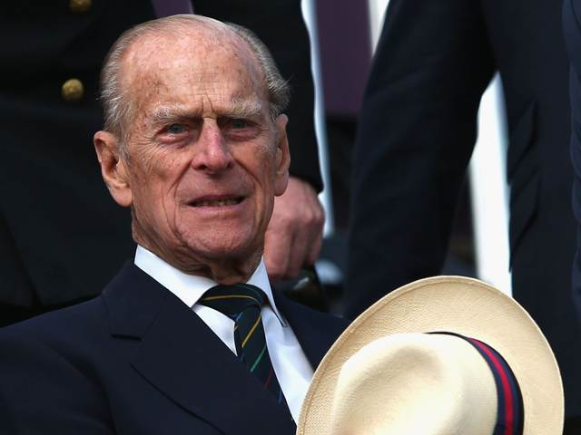
Why bother?
You get an award that is nationally recognised by colleges and universities.
You can take it further to the Silver level and Gold level.
When you complete the Gold Award you get to meet this guy:

Slide 16
Why bother?
A great way to meet new people and form new friendships.
You learn a whole range of skills that you can use in some of your GCSEs.
The DofE classes as one of your PE sport choices.
It helps within geography and your map reading skills.
It forces you to rely on yourself and become more independent.

Slide 17
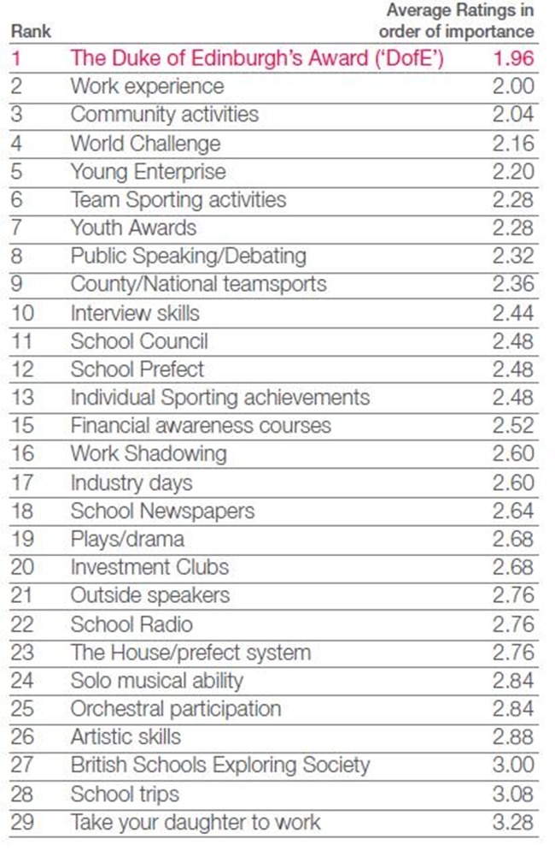
Why bother?
DofE has been ranked by major employers as one of the most important things you can do at school (after your exams of course!)

Slide 18
Skills for work!

Slide 19
So what next?
You need to come and see me at some point tomorrow!
This is your “expression of interest” – so if you do change your mind you are not ‘locked in’ to completing your DofE.
After the summer we will be asking again for firm interest.

Slide 20
Costing
£60 ~
Includes your DofE sign up pack. Campsites, some school equipment (eg. Tents).

